Slide 1

K means algorithm accelerator IP
Project by:
Liora Huf
Eddy Sraiber
Supervised by:
Shahar Gino

Slide 2
Content
Introduction to K means algorithm
Problem definition
Possible solutions
Introduction to APB protocol
Introduction to the paper
Design and Implementation –Top level
Design and Implementation – Main modules
Design and Implementation – FSM
Design and Implementation – Pipeline Diagrams
Design and Implementation – Performance
Zero Order Verification
Synthesis & Results
Layout
Summary and Conclusions

Slide 3
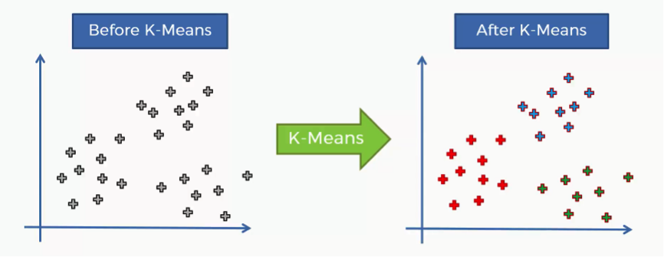
Introduction to K means algorithm

Slide 4
Motivation
Clustering is the classification of an object in different groups, or more precisely, the partitioning of a data set into subsets(clusters), so the data in each subset(ideally) share some common – often according to some defined distance measure.
K means clustering is a simple partition method to cluster n objects based on attributes into k partitions, where k<n.
K means clustering widely used in machine learning fields and image processing.
Each cluster is represented by the center of the cluster and the algorithm converges when stabilizing centroids of clusters.
Notes:
Clustering is the classification of an object in different groups, or more precisely, the partitioning of a data set into subsets(clusters), so the data in each subset(ideally) share some common – often according to some defined distance measure.
K means clustering is a simple partition method to cluster n objects based on attributes into k partitions, where k<n.
K means clustering widely used in machine learning fields.
Each cluster is represented by the center of the cluster and the algorithm converges when stabilizing centroids of clusters.

Slide 5
K means algorithm
Given the cluster number K, the K-means algorithm is carried out in 4 steps:
Initialization: randomly setting the initial centroids.
Classification: assign each object to the cluster with the nearest centroid measured with a specific distance metric.
Centroid update: Compute new centroids of the clusters given the current partition.
Convergence check: Compare new centroids to the ones from last iteration:
If they “close” to each other (their norm difference does not proceed predetermined threshold), end the algorithm.
Else, start another iteration by returning to Classification step with the new centroids.

Slide 6
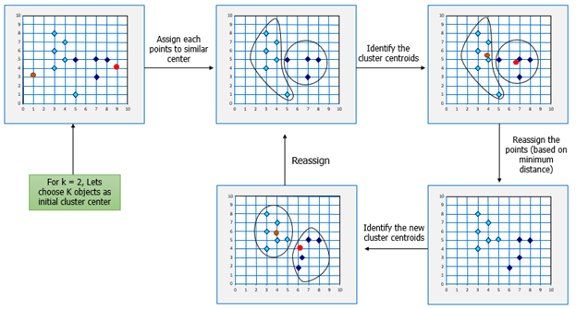

Slide 7
Problem definition
The k means algorithm although simple, could take significant amount of iterations to converge.
For large data sets, running the algorithm in software level (for example in Matlab) could result in large latency and consume a lot of resources from the processor.
Possible solution
Build a dedicated component in hardware level, in order to accelerate the running time of the algorithm.
The chosen solution - K means accelerator
The project is based on the following paper: “FPGA Implementation of K-means Algorithm for Bioinformatics Application: An Accelerated Approach to Clustering Microarray Data” by Hanaa M. Hussain, Khaled Benkrid, Huseyin Seker, Ahmet T. Erdogan.

Slide 8
Introduction to APB Protocol
The Advanced Peripheral Bus (APB) is part of the Advanced Microprocessor Bus Architecture (AMBA) protocol family.
Single master multi slave protocol
Signal transactions are only related to the rising edge of the clock
Every transaction takes at least two cycles.
It can be used to provide access to the programmable control registers of peripheral devices.
APB is a low-cost interface that is optimal for minimal power consumption.

Slide 9
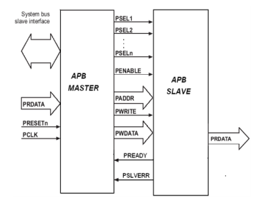
APB Protocol -signals
Signal | Source | Description
PCLK | Clock source | Clock. The rising edge of PCLK times all transfers on the APB.
PRESETn | System bus equivalent | Reset. The APB reset signal is active LOW. This signal is normally connected directly to the system bus reset signal.
PADDR | Master | Address. This is the APB address bus. It can be up to 32 bits wide and is driven by the peripheral bus bridge unit.
PSELx | Master | Select. The APB bridge unit generates this signal to each peripheral bus slave. It indicates that the slave device is selected and that a data transfer is required. There is a PSELx signal for each slave.
PENABLE | Master | Enable. This signal indicates the second and subsequent cycles of an APB transfer.
PWRITE | Master | Direction. This signal indicates an APB write access when HIGH and an APB read access when LOW.
PWDATA | Master | Write data. This bus is driven by the peripheral bus bridge unit during write cycles when PWRITE is HIGH. This bus can be up to 32 bits wide.
PREADY | Slave | Ready. The slave uses this signal to extend an APB transfer.
PRDATA | Slave | Read Data. The selected slave drives this bus during read cycles when PWRITE is LOW. This bus can be up to 32-bits wide.
PSLVERR | Slave | This signal indicates a transfer failure. APB peripherals are not required to support the PSLVERR pin. This is true for both existing and new APB peripheral designs. Where a peripheral does not include this pin then the appropriate input to the APB bridge is tied LOW.

Slide 10
APB Protocol – operating states
The state machine operates through the following states:
IDLE –
This is the default state of the APB.
SETUP
When a transfer is required the bus moves into the SETUP state,
Select signal, PSELx, is asserted.
Always moves to the ACCESS state on the next rising edge of the clock.
ACCESS
The enable signal, PENABLE, is asserted.
The address, write, select, and write data signals must remain stable during the transition from the SETUP to ACCESS state.
Exit from the ACCESS state is controlled by the PREADY signal from the slave:
PREADY is LOW : remains in the ACCESS state.
PREADY is HIGH : bus returns to IDLE state.
Notes:
The state machine operates through the following states:
IDLE - This is the default state of the APB.
SETUP - When a transfer is required the bus moves into the SETUP state, where the appropriate select signal, PSELx, is asserted. The bus only remains in the SETUP state for one clock cycle and always moves to the ACCESS state on the next rising edge of the clock.
ACCESS - The enable signal, PENABLE, is asserted in the ACCESS state. The
address, write, select, and write data signals must remain stable during
the transition from the SETUP to ACCESS state. Exit from the ACCESS state is controlled by the PREADY signal from the slave:
• If PREADY is held LOW by the slave then the peripheral bus remains in the ACCESS state.
• If PREADY is driven HIGH by the slave then the ACCESS state is exited and the bus returns to the IDLE state if no more transfers are required. Alternatively, the bus moves directly to the SETUP state if another transfer follows.

Slide 11
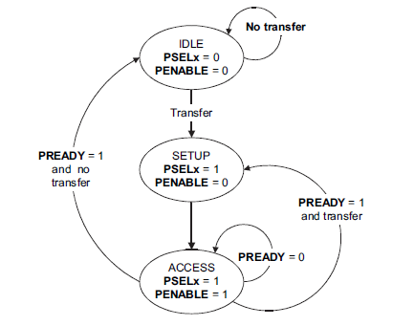
APB Protocol –Operating states
The figure bellow describes the operating states of the protocol:

Slide 12
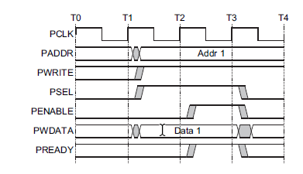
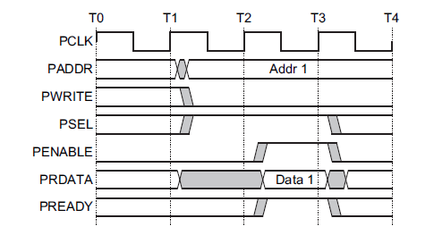
APB Transactions
Write Transfer
Read Transfer

Slide 13
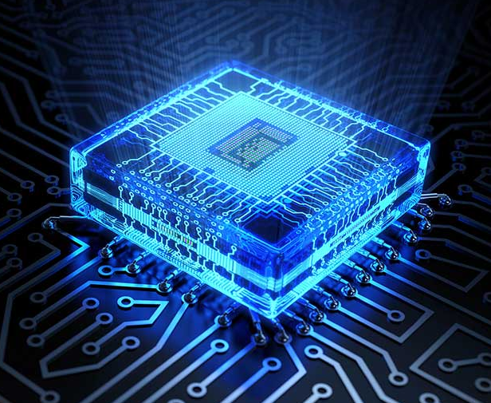
Hardware implementation

Slide 14
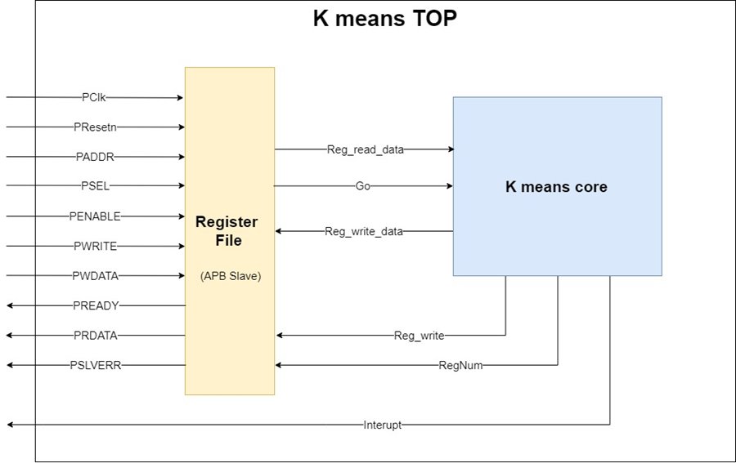
Design and Implementation – Top level
The high-level architecture composed of two main modules - The “Register file” and the “K means core”.

Slide 15
Design and Implementation – Top level
The “Register file” – communication mediator:
Communicate with the CPU host by APB protocol, as APB slave, and store income data.
Communicate with “K means core”, and store output data as well as during algorithm data such as cluster centroids, by allowing read and write to its registers.

Slide 16
Design and Implementation – Top level
The “K means core” module – the “brain”.
Run the algorithm, when finished – throw an interrupt to CPU host (passed through the “Register file”).
Include a local RAM for restoration of the data set , the data is written to it through the “Register file”, by APB protocol as mentioned above

Slide 17
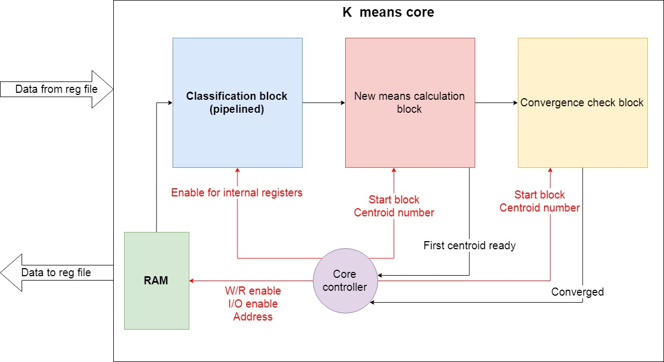
Design and Implementation – K means Core
Main Modules:
Controller (FSM)
Classification Block
New Means Calculation Block
Convergence Check Block

Slide 18
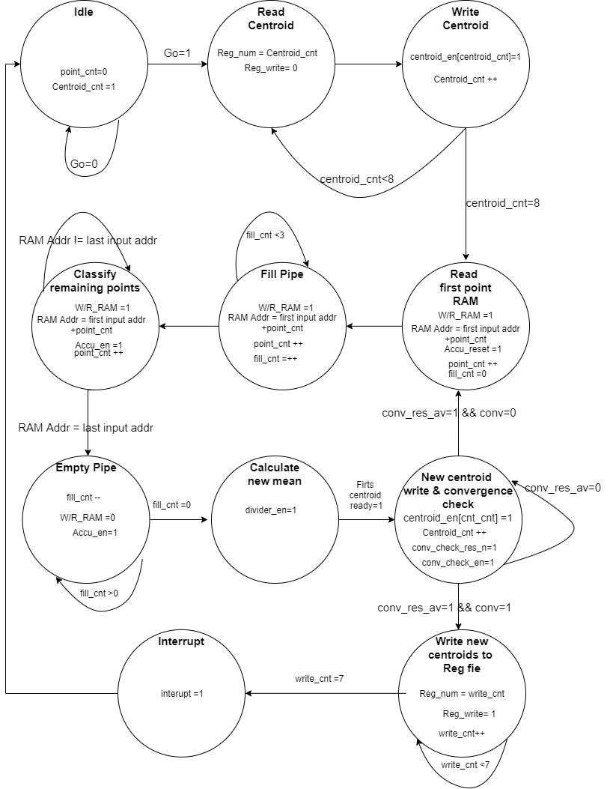
Controller
The controller is an FSM which controls the core setting signals connected to the other blocks in the core and to the register file block.

Slide 19
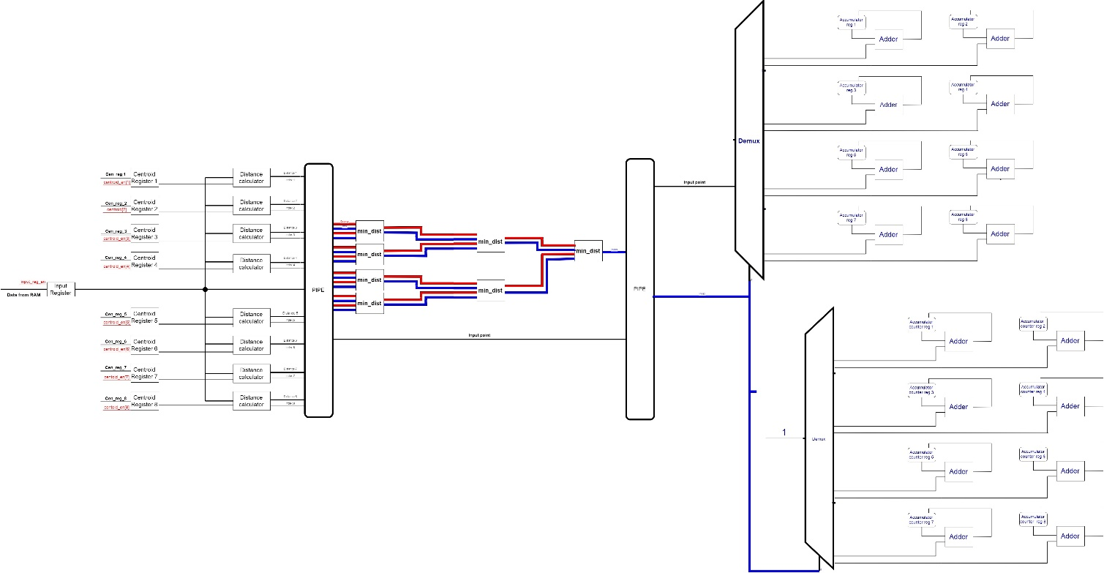
Classification block High-Level
The “Classification block” composed of 3 pipelined components.
The block is responsible for classifying input data points into the cluster.
It has a throughput of one data point per cycle and latency of four cycles.
Notes:
latency of four cycles:
one for reading the data from the RAM,
one for calculating the distance between the centroid and the point,
one to determine to closest centroid,
one for adding to point to the accumulator.

Slide 20
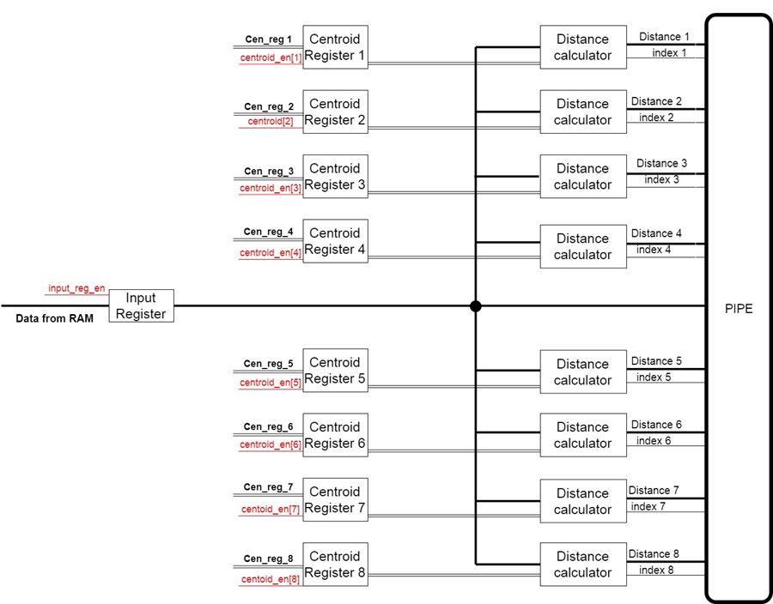
Classification block First component
First component’s goal is to perform distance calculation between input data point with each of the centroids.
Distance calculation is done by taking the absolute value of the difference, per coordinate, and sum result’s from each coordinate.
Notes:
The distance calculation from the input data point (stored in the “Input register”) to the centroids, which are stored in local registers called “Centroid Register X” (X being a integer from 1 to 8). This calculation is done by o module called “Distance calculator” which is basically two sub modules in series: the first calculates the subtraction of the data in the input register from the data in centroid register “X”, the second is a module which calculates the absolute value of the mentioned subtraction.

Slide 21
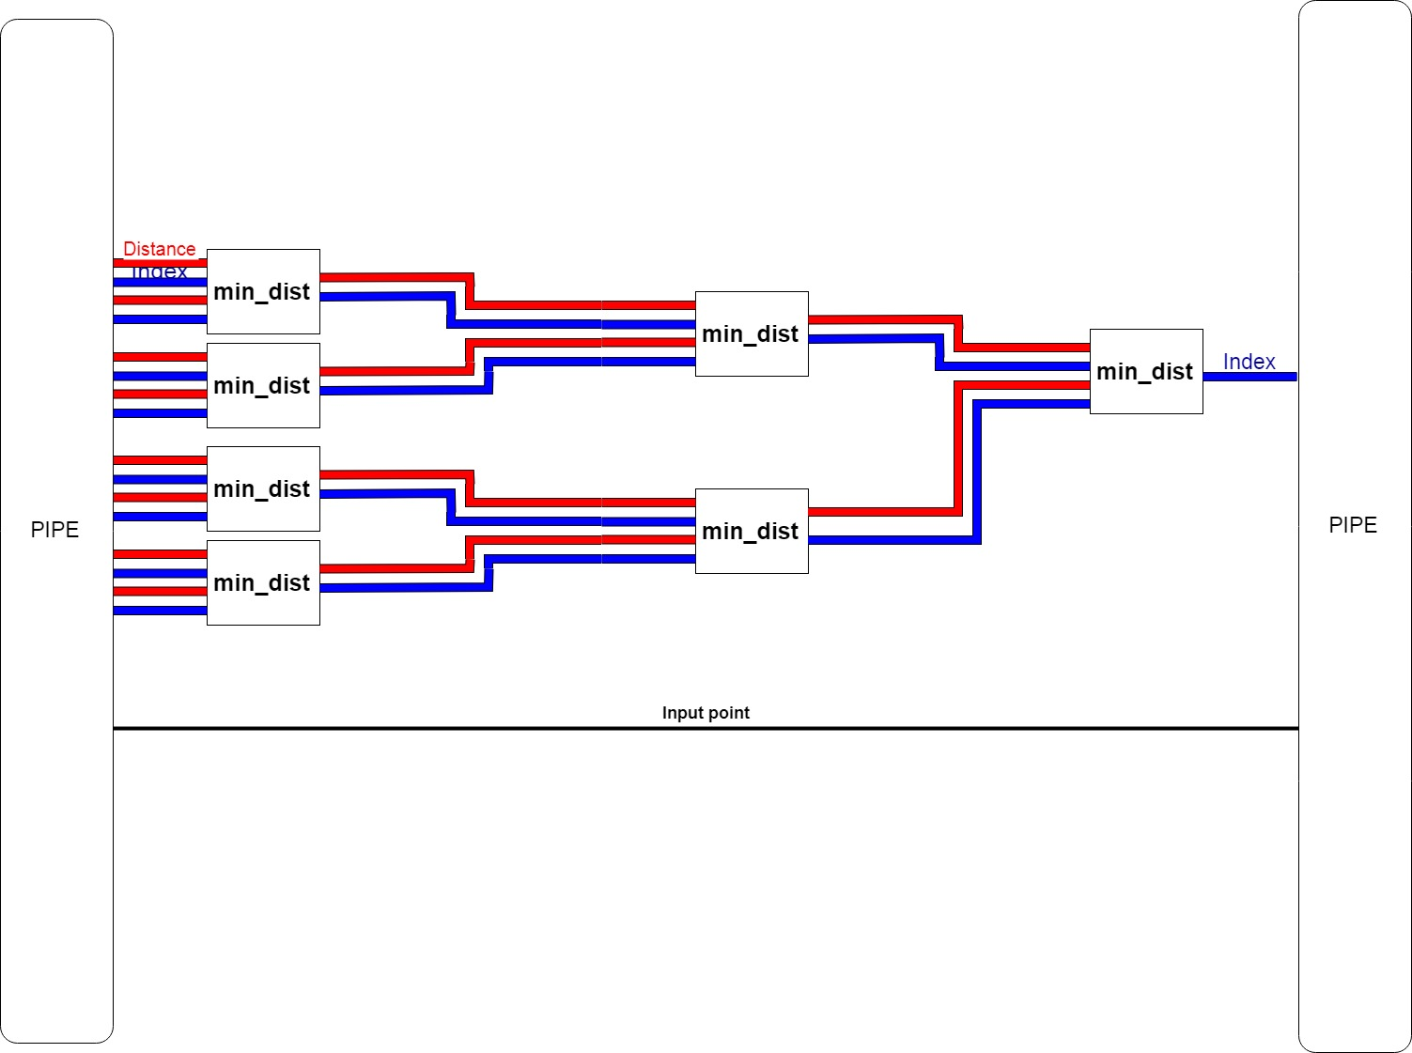
Classification block Second component
The second part goal is to find the closest centroid to the input point.
In this part, all the distances from the first component are compared.
The index of the closest centroid is found and passed to the third component.
Notes:
distance calculation

Slide 22
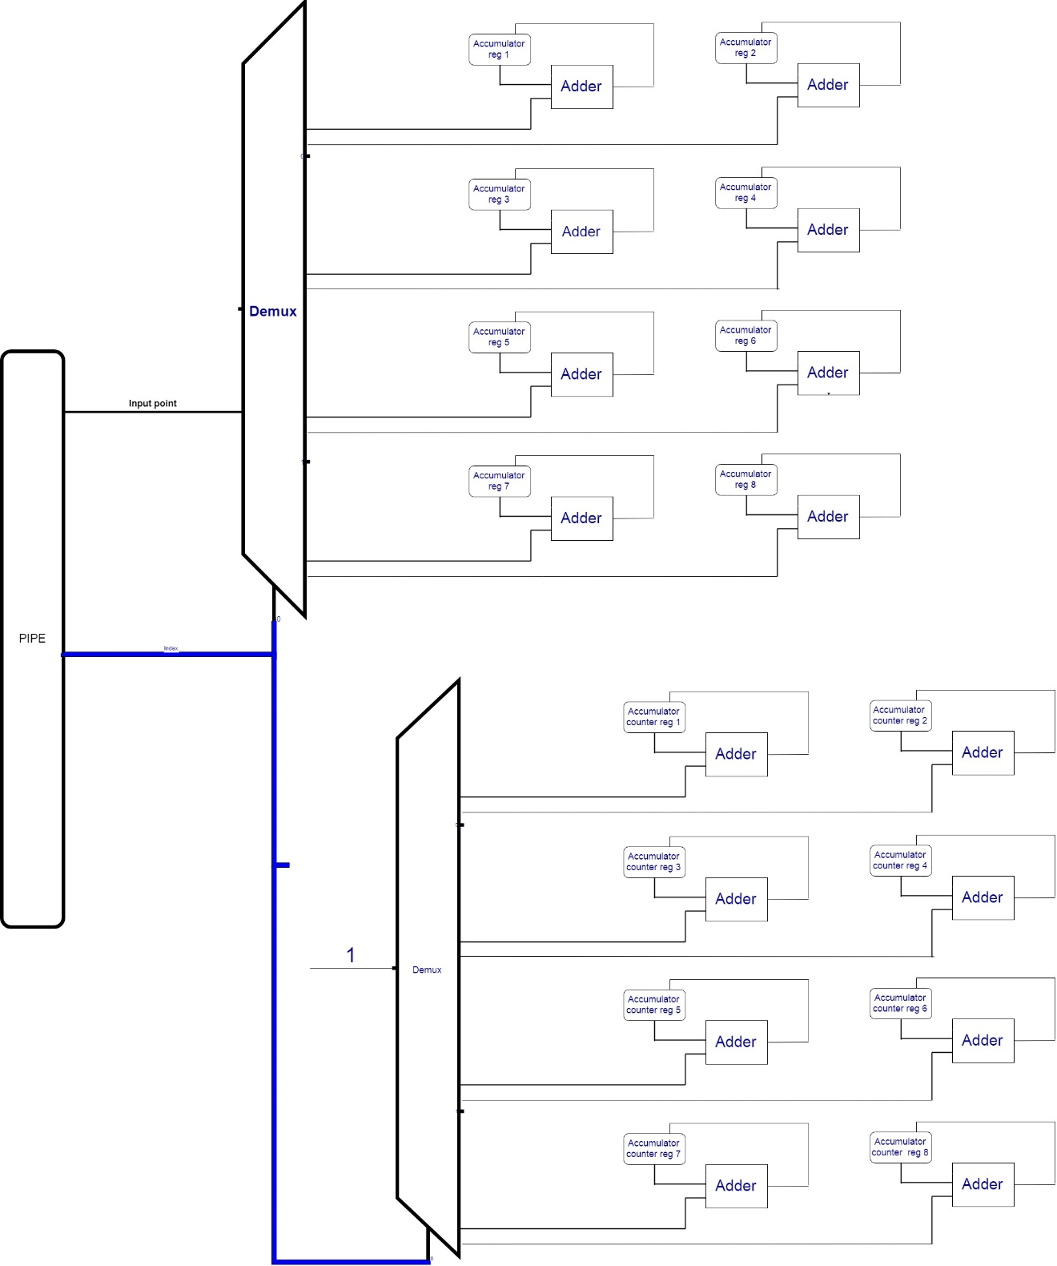
Classification block Third component
The third component goal is to accumulate, per each centroid, all the data points which are closest to it rather than other centroids.
By the index received from the second component, we determine which centroid’s, the input point is closest to.
The input point added to formerly accumulated value which is the summation of former assigned points to the current centroid, for the current iteration.
Notes:
The component consist sixteen registers: eight accumulators registers and eight counters registers.
Each accumulator represents a cluster and stores the summed of all points assign to this cluster at a given time. The counters are register which simply keep track of how many points were assigned to each cluste The index received from the previous part is used as a selector for two decoders, in order to choose to each accumulator, register and counter register the input data point should be added.

Slide 23
New means calculation block Division method
Floating point representation for division consists of unwanted characteristics, such as time-demanding, high complexity.
The proposed architecture works with fixed-point representation. Therefore, there was a need to find a proper way to divide fixed-point values.
The proposed method:
Convert the fixed-point number to an integer by shifting all fractional bits left.
Dividing the converted number using an integer divider.
Shifting right the result to return to fixed-point representation.
Notes:
Duo to the complexity and time demanding characteristics of the floating point representation, the proposed architecture works with the fixed point representation. Therefore, there was a need to find a proper way to divide fixed point values.
The proposed method was to convert the fixed point number to an integer by shifting all fractional bits left (multiplying by 1024 ), dividing the converted number by using an integer divider(with known an simple algorithms, as describe in section Division in Hardware in the project report), and after the division shifting right the result in order to return to the fixed point representation.

Slide 24
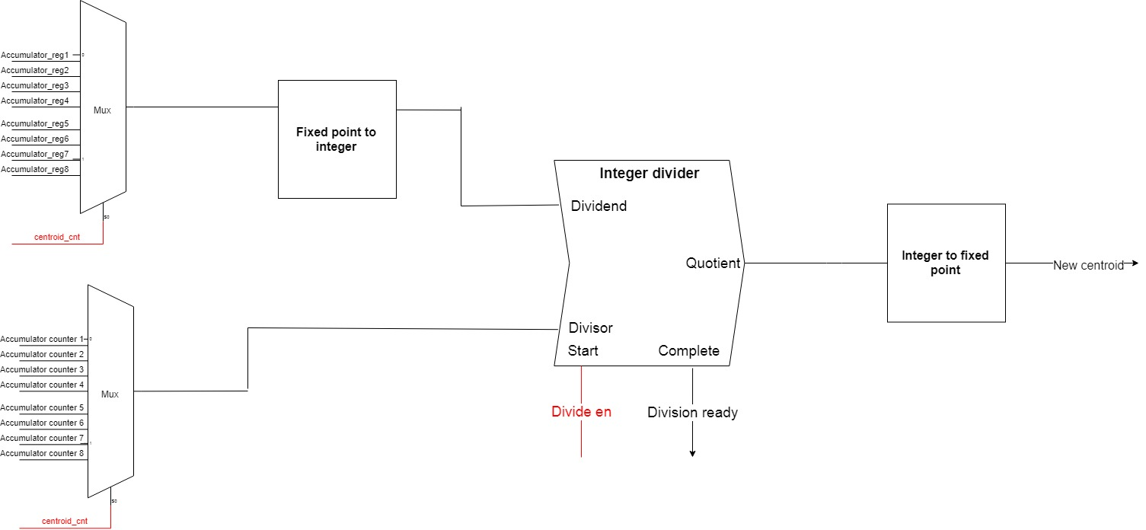
New means calculation block Implementation
Current block is responsible for the centroids update step of the algorithm.
It does so by dividing the value of each accumulator by the number of points assigned to them.
Notes:
The “New Means Calculation block” is responsible for centroids update step of the algorithm. It does so by dividing the value of each accumulator(stored at the local “Accumulator reg” register in the “Classification block”) by the number of points assigned to them(stored at the local “Accumulator counter reg” register in the “Classification block”).

Slide 25
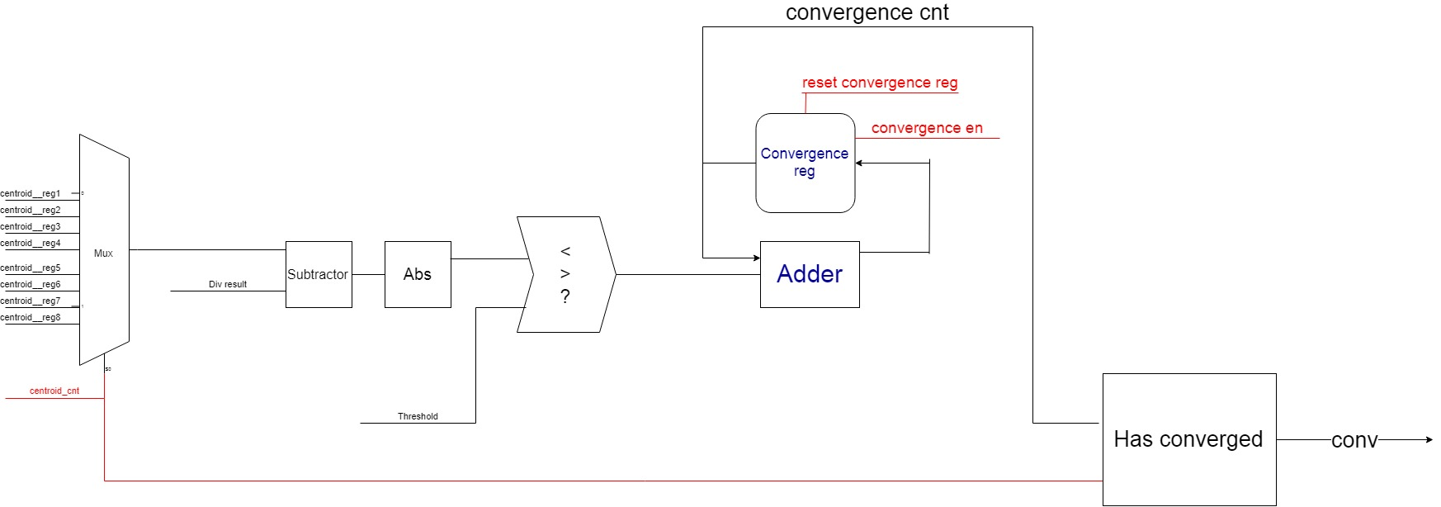
Convergence check block
Current block is responsible for the convergence check step of the algorithm.
It does so by checking if each of the new centroids calculated in the former block is “close enough” to its value from the beginning of the iteration.
Notes:
The convergence check block is responsible for the convergence check step of the algorithm. It does so by checking if any of the new centroids calculated in the “New Means Calculation block” value is close enough (within a pre-decided threshold stored at “Threshold register ” in the register file) to its old value(the value stored in the beginning of the iteration, stored in local registers of the classification block).

Slide 26
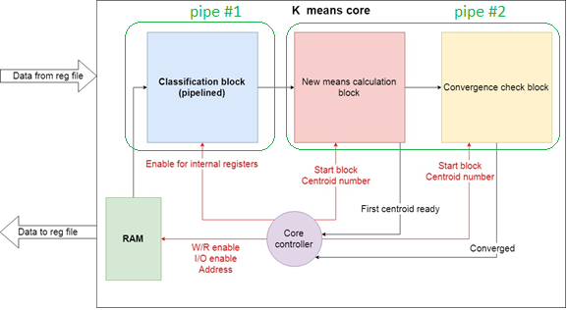
Why this architecture?

Slide 27
Why this architecture?
There is a Read-After-Write dependency between the 2 pipes.
At each moment, only one of the pipes is working.
Notes:
K means core pipeline view is divided into two pipelines, the division can be seen in the figure attached. The reason for this division is the Read-After-Write dependency between the 2 pipes. This results by having one pipe working while the other wait for it's results. The left pipe result is all data points classified to clusters, which then can be used to calculate the new means for next iteration (or the last means if there will be a convergence). Then for the next iteration of classifying the data points, the new means value has to be ready, therefore the first pipe will "sleep" until second pipe will finish bringing the result of calculating new means

Slide 28
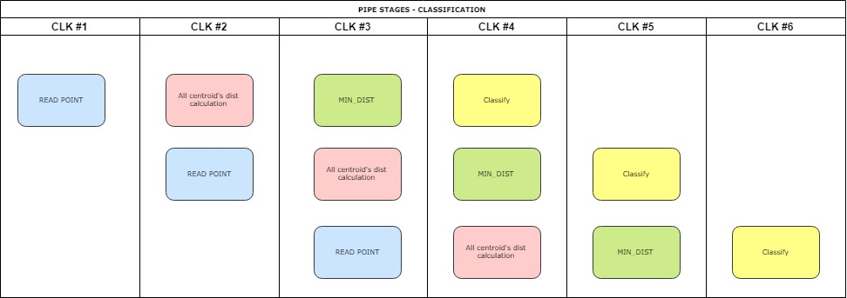
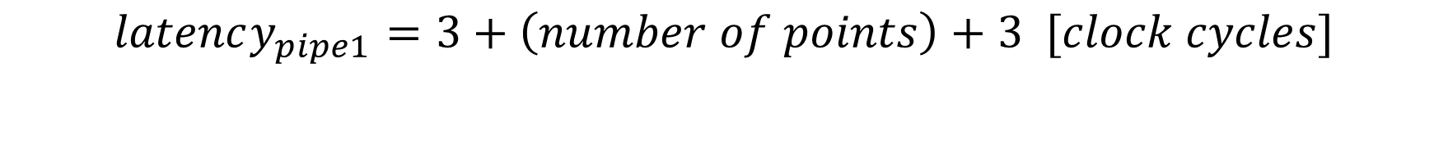
First Pipeline Latency
$$latency_{pipe1}=3+\left(number of points\right)+3 [clock cycles]$$
Notes:
Three clock cycles are needed to fill this module pipeline. After the pipeline is filled, every clock cycle a new point is classified. As the final data point enters the pipeline, it must go thought the pipeline stages, hence three more clock cycles are needed to complete the classification block functionality.
$$latency_{pipe1}=3+\left(number of points\right)+3 [clock cycles]$$

Slide 29
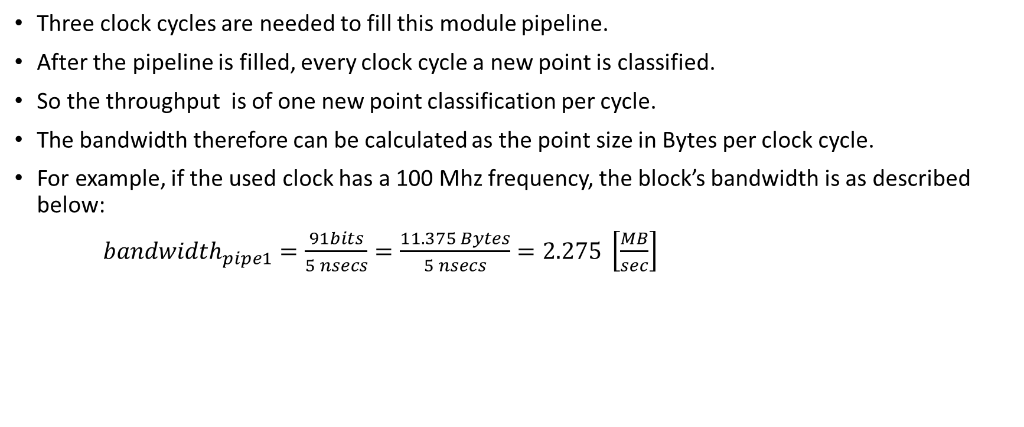
First Pipeline Throughput
Three clock cycles are needed to fill this module pipeline.
After the pipeline is filled, every clock cycle a new point is classified.
So the throughput is of one new point classification per cycle.
The bandwidth therefore can be calculated as the point size in Bytes per clock cycle.
For example, if the used clock has a 100 Mhz frequency, the block’s bandwidth is as described below:
$bandwidth_{pipe1}=\frac{91bits}{5 nsecs}=\frac{11.375 Bytes}{5 nsecs}=2.275 \left[\frac{MB}{sec}\right]$
Notes:
Second, the classification block is a pipelined module, therefore first latency component is the number of cycles needed to fill this pipeline. The classification block consists of three main parts, as explained in section ‎2.6.2.2, as a result three clock cycles are needed to fill this module pipeline.
After the pipeline is filled, every clock cycle a new point is classified, resulting in a throughput of one new point classification per cycle. The bandwidth therefore can be calculated as the point size in Bytes per clock cycle. In the described design, each data point has a bit width of 91 bits, thus the bandwidth of the classification block is 91 bits per clock cycle period. For example, if the used clock has a 100 Mhz frequency, the block’s bandwidth is as described below:
$$bandwidth_{pipe1}=\frac{91bits}{5 nsecs}=\frac{11.375 Bytes}{5 nsecs}=2.275 \left[\frac{MB}{sec}\right]$$
As the final data point enters the pipeline, it must go thought the pipeline stages, hence three more clock cycles are needed to complete the classification block functionality.

Slide 30
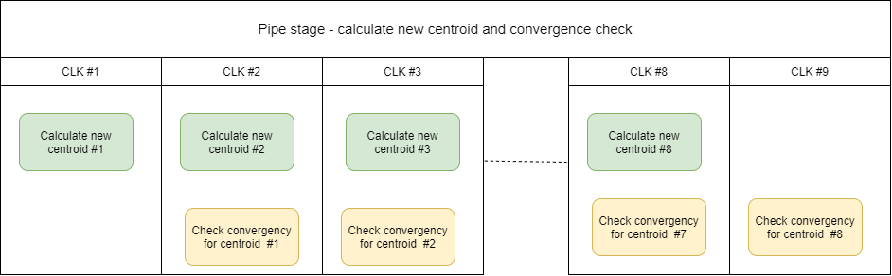
Second Pipeline Latency
$$latency_{pipe2}=\left(\#centroid\right)∗\left(2+1\right)+1$$
$$latency_{pipe2}=8∗\left(2+1\right)+1$$
Notes:
The latency of the second pipeline eight times the number of cycle to calculate the division for the new centroid(2), plus the number of cycles to check the convergence of a centroid(1), and at the one extra cycle at the end:

Slide 31
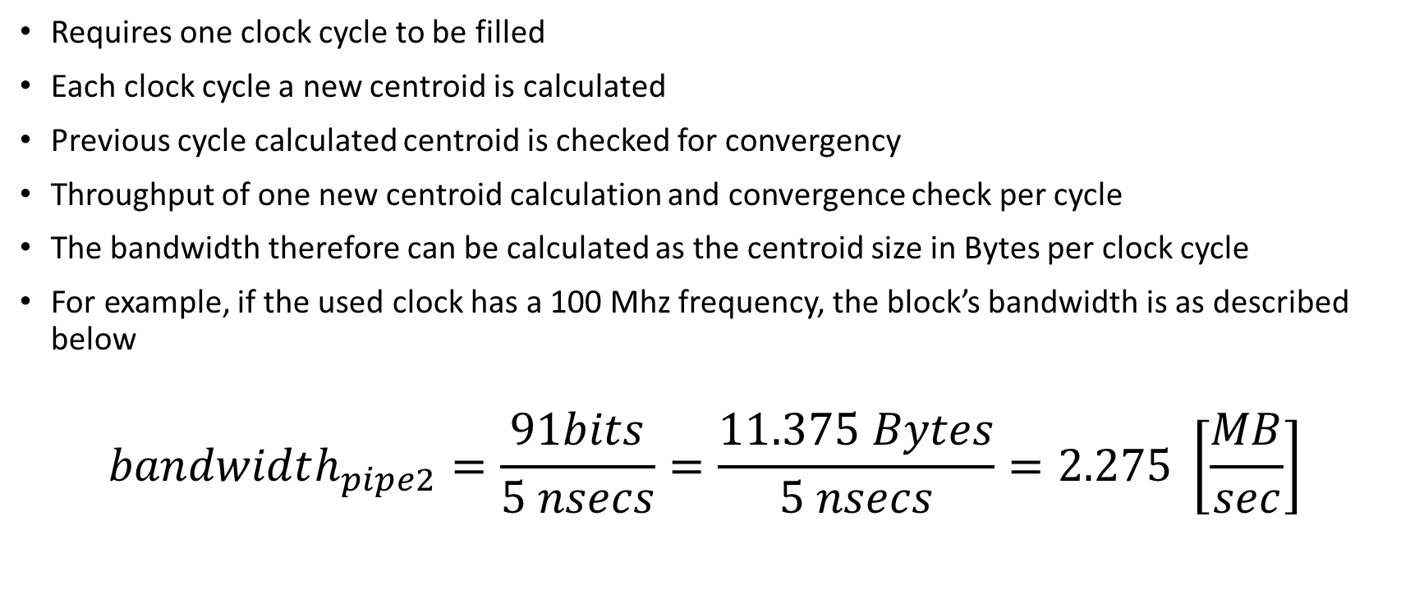
Second Pipeline Throughput
Requires one clock cycle to be filled
Each clock cycle a new centroid is calculated
Previous cycle calculated centroid is checked for convergency
Throughput of one new centroid calculation and convergence check per cycle
The bandwidth therefore can be calculated as the centroid size in Bytes per clock cycle
For example, if the used clock has a 100 Mhz frequency, the block’s bandwidth is as described below
$$bandwidth_{pipe2}=\frac{91bits}{5 nsecs}=\frac{11.375 Bytes}{5 nsecs}=2.275 \left[\frac{MB}{sec}\right]$$
Notes:
As this pipeline consists of two modules, it requires one clock cycle to be filled. After the pipeline is filled, each clock cycle a new centroid is calculated and the calculated in the previous cycle is checked for convergency. Accordingly, a throughput of one new centroid calculation and convergence check per cycle. The bandwidth therefore can be calculated as the centroid size in Bytes per clock cycle. In the described design, each centroid has a bit width of 91 bits, thus the bandwidth of the classification block is 91 bits per clock cycle period. For example, if the used clock has a 100 Mhz frequency, the block’s bandwidth is as described below:
$$bandwidth_{pipe2}=\frac{91bits}{5 nsecs}=\frac{11.375 Bytes}{5 nsecs}=2.275 \left[\frac{MB}{sec}\right]$$

Slide 32
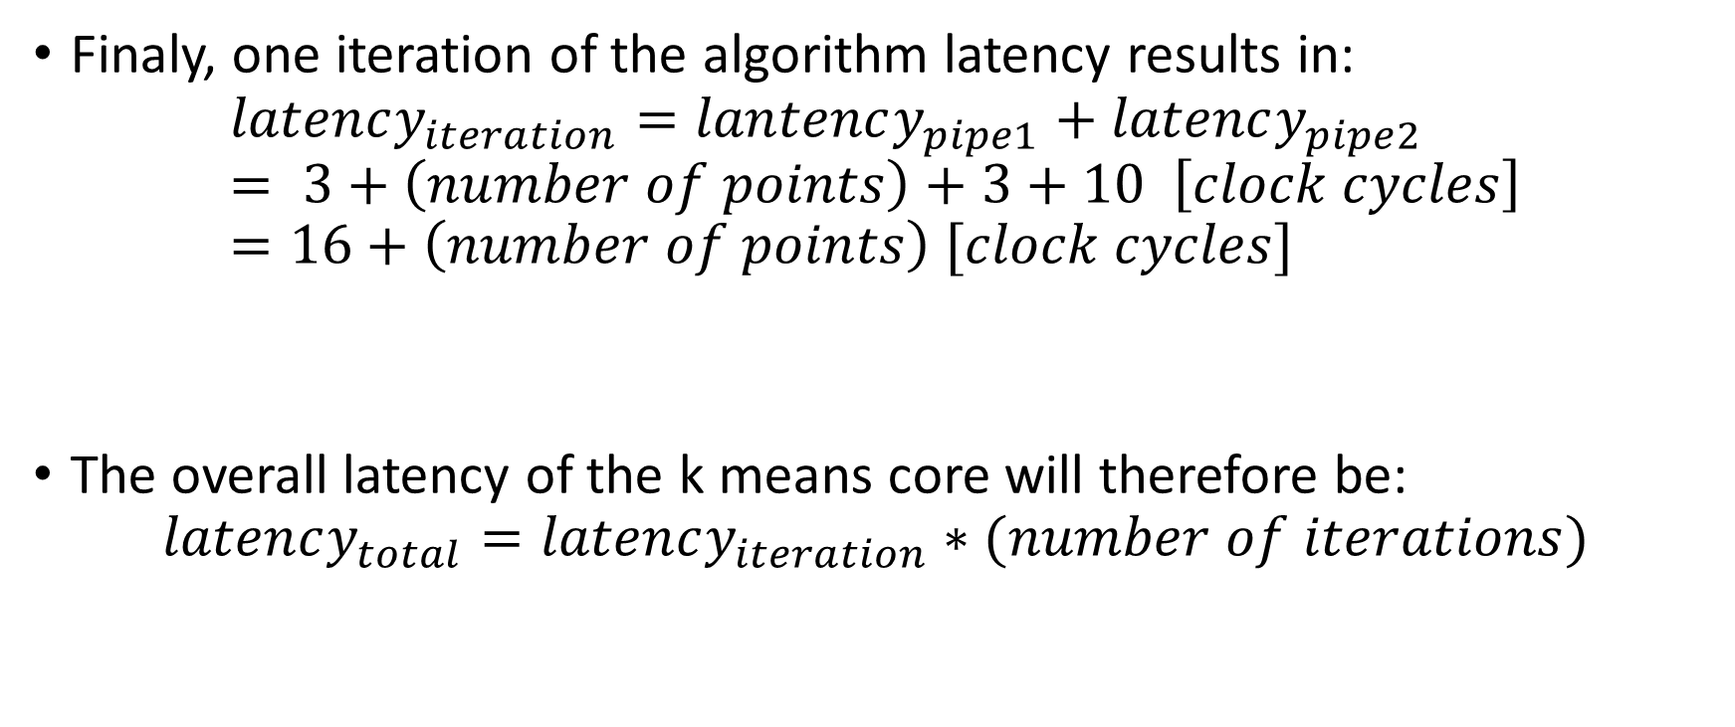
Total Pipeline Latency
Finaly, one iteration of the algorithm latency results in:
$$latency_{iteration}=lantency_{pipe1}+latency_{pipe2}= 3+\left(number of points\right)+3+10 \left[clock cycles\right]=16+\left(number of points\right) [clock cycles]$$
The overall latency of the k means core will therefore be:
$$latency_{total}=latency_{iteration}∗(number of iterations)$$

Slide 33

Verification

Slide 34
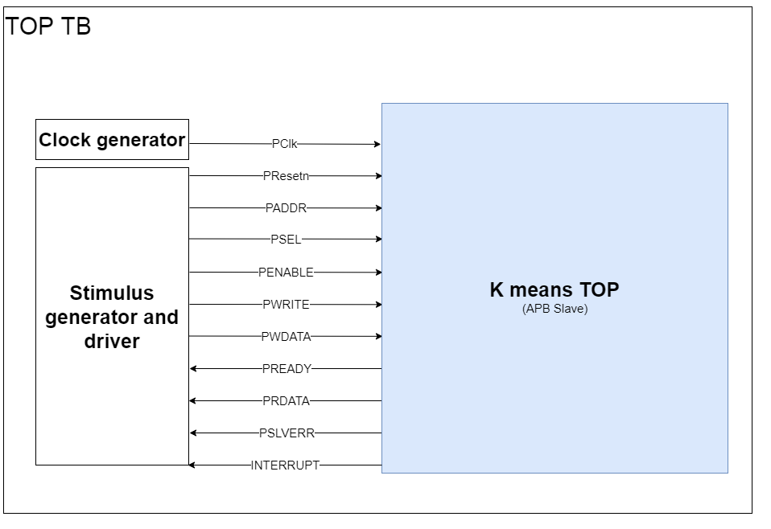
Zero order verification
The testbench below made in order to verify the implementation of the design.
Its structure shown below, and it is composed by:
Instantiation of the K means TOP (The verified DUT).
Clock generator.
Stimulus generator
Driver.
Notes:
The testbench made in order to verify the implementation of the design described herein was called top_tb.sv. Its structure is as shown below. It is basically composed by an instantiation of the K means TOP (which is the verified DUT), a clock generator and a stimulus generator and driver.

Slide 35
Zero order verification – test bench
Two actual tests were implemented in the described testbench:
Description | Test Bench Type
Verify the functionality of the k means top module, with a simple example. | Sanity
Verify the case that k means top module should not change the initial centroid values because they are the same as the data points, therefore being the expected final centroid values. | Do Nothing

Slide 36
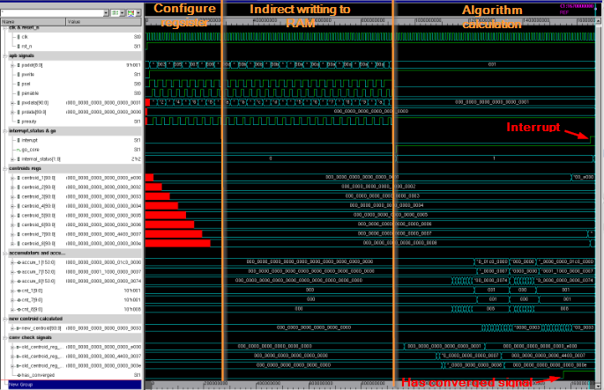
Zero order verification Results “Sanity Check”
The main parts of the IP functionality were:
Configures registers in the RegisterFile block, such as centroid’s and RAM info related centroids.
Write the data point to the RAM via indirect access.
Algorithm calculation:
centroid registers, accumulators and accumulator counters can be seen changing with the progress of the algorithm.
The “Has converged” signal was marked in its rising edge, meaning the algorithm has reached convergence.
Afterwards, the “interrupt” signal was marked in its rising edge.
Notes:
The main parts of the IP functionality were marked In the attached figure.
First, the testbench configures the centroid’s registers with their initial value, as well as the registers which contain the RAM first and final addresses. This part was named “Configure registers” in the attached figure.
Then, the testbench writes the data point to the RAM via indirect access. This part was named “Indirect writing to RAM” in the attached figure.
Finally, in the attached figure, in the part called “Algorithm calculation”, centroid registers, accumulators and accumulator counters can be seen changing with the progress of the algorithm. Also, in this part, the “Has converged” signal was marked in its rising edge, meaning the algorithm has reached convergence. Eight clock cycles after this occurs, the “interrupt” signal was marked in its rising edge, meaning the core is communicating to its host that it has finished its purpose.

Slide 37
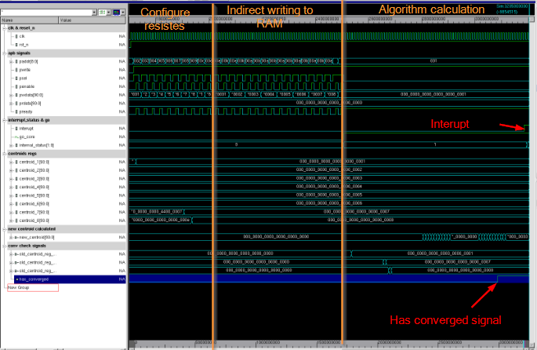
Zero order verification Results “Do nothing test”
The test passed successfully.
It compares at its first iteration the initial centroid values with the calculated ones and concludes the algorithm has converged.
Notes:
As it can be seen from the attached figure, the “Do nothing” test indeed works. It compares at its first iteration the initial centroid values with the calculated ones and concludes the algorithm has converged.

Slide 38
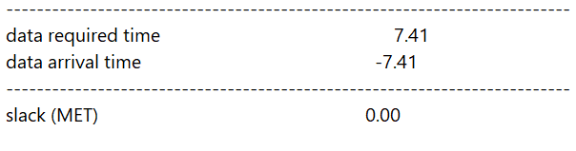
Synthesis and Results
Technology:
Synthesis Tool: design_vision Of Synopsys.
Technology: TowerTSL018.
The synthesis took place with a symmetric clock, with frequency of 133.3 [MHz].
It is to be noted that the RAM's are working on negative clock.
There were no more constraints added to this synthesis process.
The slack is MET, as it can be seen form the attached report:

Slide 39
Synthesis - Power and Area
From power report, the summary of total power can be obtained as follow:
From area report, the summary of areas can be obtained as follow:

Slide 40
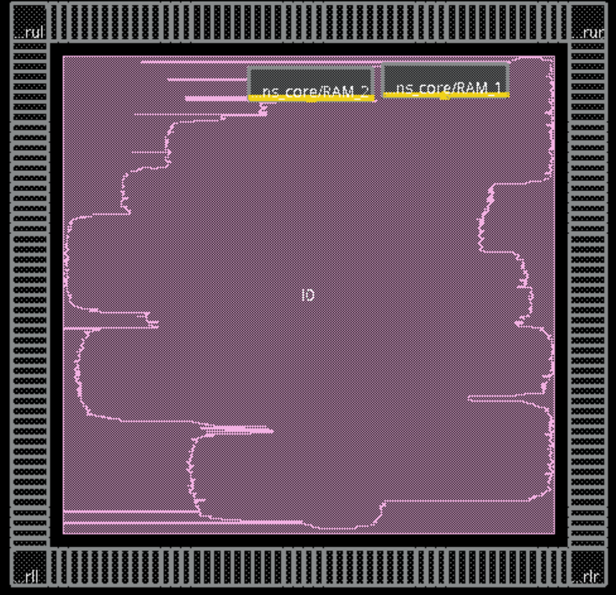
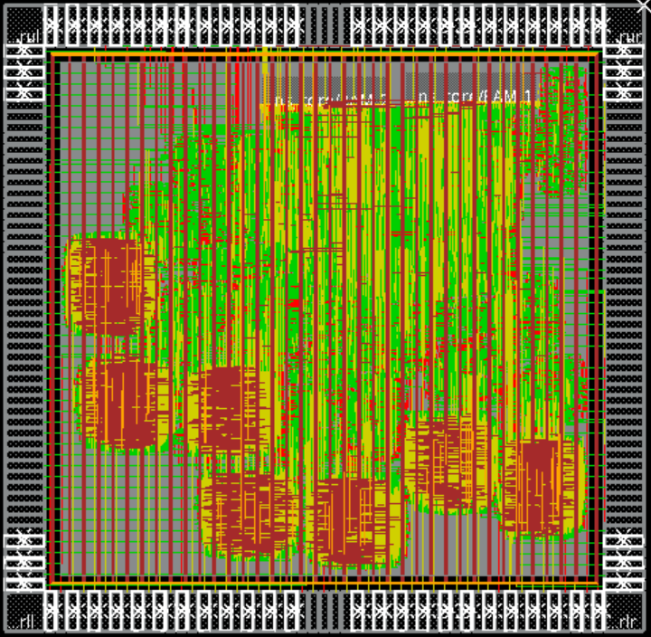
Layout
As extracted from Innovus tool, the chip utilization and chip area presented below:
Floorplan View

Slide 41
Summary and conclusions
In this section, a brief summary of this project is done and our conclusions exposed.
This section will be divided into three.
Innovations in our design compared to the design present in the paper.
Analysis of the achieved performance of the IP.
Describing possible future improvements of the IP.
Notes:
In this section, a brief summary of this project is done and our conclusions exposed. This section will be divided into three. First, a summary about the innovations in our design compared to the design present in the paper this project was based on. Then, an analysis of the achieved performance of the IP and finally a section describing future improvements of the IP.

Slide 42
Summary and conclusions Design Innovations
The proposed paper has specific RAM and DIV units. Due to academic limits – there was a choice for a DIV that will provide performance despite this limitation.
In our design, there is a clear interface description, which was not addressed in the paper. We chose to use APB communication protocol, Because of its simplicity and wide use in the industry, as our interface protocol.
The main difference is the microarchitecture implementation extension. In our project, we extended microarchitecture, down to private implementation, where the paper did not proceed further than high-level specifications.
Notes:
One main different are the units used for the architecture – the proposed paper has a specific RAM and DIV units. Due to academical limits – there was a choice for a DIV that will provide performance despite this limitation – for more refer to section ‎2.6.2.3.
Another difference is the interface description. Although the paper proposes an IP architecture, it does not explicit explain the interface specifications, therefore not being clear how the IP could be integrated with a CPU. In our design, there is a clear interface description as described in section ‎2.5. Because of its simplicity and wide use in the industry, we choose to use APB communication protocol (as presented in chapter 1 - where the CPU should be the master and the K means IP is the slave) as our interface protocol.
The last main difference we would like to mention is the micro architecture implementation extension. Even though the paper presents a k means-core architecture, it does not extend on the low level implementation. In our project, micro architecture, down to private implementation, was extended.

Slide 43
Summary and conclusions Achieved Performance
The total running time of the algorithm in our IP for the example described in section ‎4.2.1 was of 167*10^7 [fsec]=1.67 [μsec] for a simulation done with clock cycle set at 10 [nsec].
With correspondence to synthesis clk which is 7.5[nsec], the actual runtime would be a total of 1.2525[μsec] (For the example mentioned).
In the other hand, the Matlab script used to verified the correctness of the output for input example described in section ‎4.2.1 took approximately 1.68 [sec], meaning the speedup for the algorithm using the IP was of 1.34*10^6.
Notes:
The total running time of the algorithm in our IP for the example described in section ‎4.2.1 was of 167*10^7 [fsec]=1.67 [μsec] for a simulation done with clock cycle set at 10 [nsec]. Duo to the fact that in our Synthesis process we set the clock cycle to be 7.5[nsec], the actual running time of the K means IP for the example described in section ‎4.2.1 was would be a total of 1.2525[μsec] .
In the other hand, the Matlab script used to verified the correctness of the output for input example described in section ‎4.2.1 took approximately 1.68 [sec], meaning the speedup for the algorithm using the IP was of 1.34*10^6.

Slide 44
Summary and conclusions Future improvements – 1/2
Large dividers negatively affect total area and critical path.
Handle division with smaller dividers might improve both characteristics, at the cost of the calculation accuracy.
In our design, the number of clusters was predetermined.
A modification of the code could be changed to allow a parametrical amount of centroids.
In our design, the input data size and dimensions were predetermined.
The code can be changed to allow the user to choose the input data size and dimensions parametrically.
Notes:
• The use of large dividers affects not only the total area size, but also it sets the critical path. A way of solving (even if partially) this problem could be using smaller dividers, at the cost of the calculation accuracy. Future analysis could be done to the better describe the tradeoff between calculation accuracy and time and area constrains and choose the optimal DIVIDERS size.
• In our design, the number of clusters was predetermined to be eight. For future improvement, the code could be changed to allow the user to choose how many clusters to use in the algorithm.
• In our design, the input data size and dimensions were predetermined. For future improvement, the code could be changed to allow the user to choose the input data size and dimensions of the algorithm.
• A maximum iterations feature could be added to the design. As it is not certain the number of iterations it will take for the algorithm to reach convergence, a future register could be added enabling the user to set maximum number of iterations wanted to be ran, ending the algorithm after this predetermined number of iterations whether convergence has been achieved or not.
• Duo to the chosen architecture of two data dependent pipelines which run in series, the clock domain could be improved by having one clock for each pipeline. In this manner, at least one of the pipelines (the slower one between the two) could have better performance, improving the overall performance. This could possible be done also for the Register File, allowing the APB communications to be faster and therefore improving even more the total performance.

Slide 45
Summary and conclusions Future improvements – 2/2
A maximum iterations feature could be added to the design.
To handle convergence issues, a future register could be added enabling to set a maximum number of iterations.
The chosen architecture consist of data dependent pipelines which run in series, therefore, the clock domain could be split for sub-domains:
Split the clk domain for the two pipelines at K means core.
Split clk domain at the Register File, allowing the APB communications to be separated from the calculation at K means core.
Notes:
• The use of large dividers affects not only the total area size, but also it sets the critical path. A way of solving (even if partially) this problem could be using smaller dividers, at the cost of the calculation accuracy. Future analysis could be done to the better describe the tradeoff between calculation accuracy and time and area constrains and choose the optimal DIVIDERS size.
• In our design, the number of clusters was predetermined to be eight. For future improvement, the code could be changed to allow the user to choose how many clusters to use in the algorithm.
• In our design, the input data size and dimensions were predetermined. For future improvement, the code could be changed to allow the user to choose the input data size and dimensions of the algorithm.
• A maximum iterations feature could be added to the design. As it is not certain the number of iterations it will take for the algorithm to reach convergence, a future register could be added enabling the user to set maximum number of iterations wanted to be ran, ending the algorithm after this predetermined number of iterations whether convergence has been achieved or not.
• Duo to the chosen architecture of two data dependent pipelines which run in series, the clock domain could be improved by having one clock for each pipeline. In this manner, at least one of the pipelines (the slower one between the two) could have better performance, improving the overall performance. This could possible be done also for the Register File, allowing the APB communications to be faster and therefore improving even more the total performance.

Slide 46
Thank you

